Slide 1

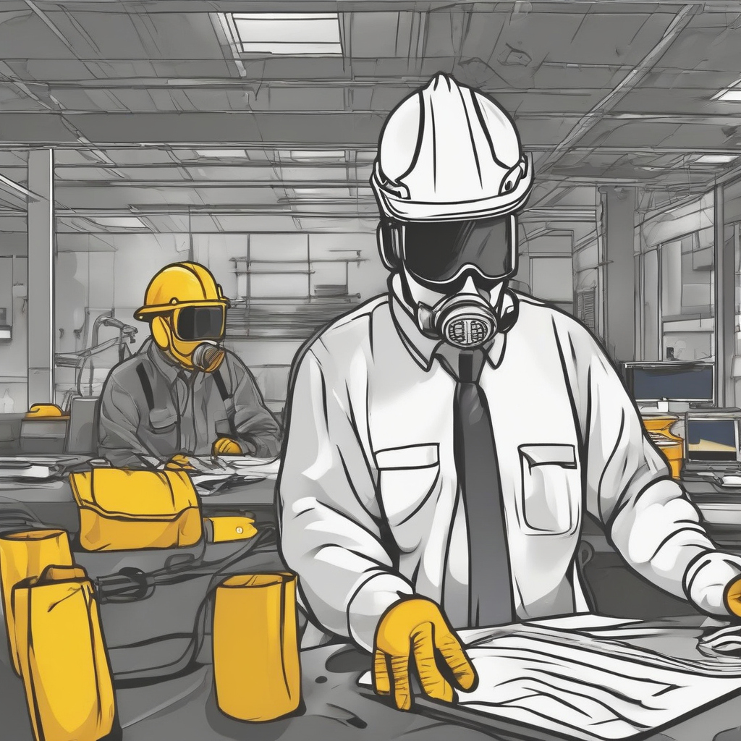
GearCheck AI
Group:8
Student Name​ | Student Id​
Muhammad Bilal Dilbar ​ | 101494128​
Krishna Ashokbhai Zala​ | 101499418​
Simran Nisarg Modi​ | 101486407​
Gowtham Katari​ Professors: Vejey Gandyer and Moe Fadaee | 101479063​

Slide 2
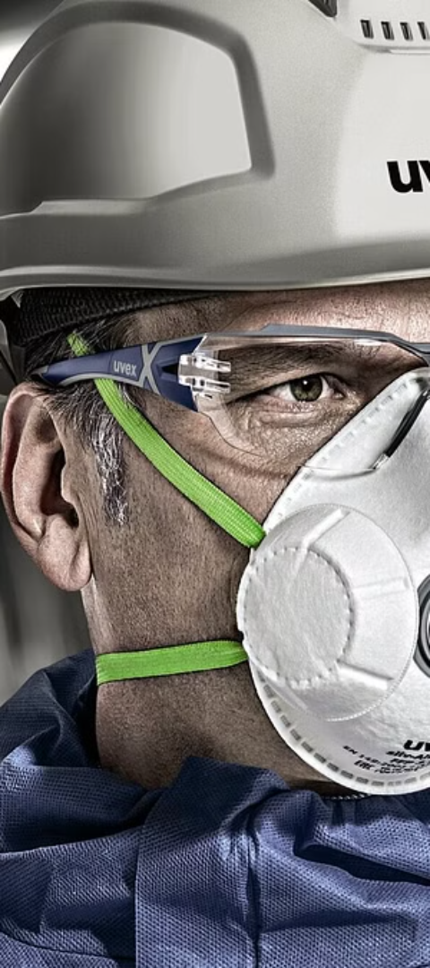
Agenda
Introduction
Problem Statement
Significance
Solution
Cost/Benefit Analysis
Business case
KPIs
Literature Reviews
ML Canvas
Model Training & Benchmarking
Model Deployment
Demo/Proof of concept
Challenges & Issues Encountered
Future Scope
Q & A

Slide 3
Introduction
The project aims to develop a computer vision-based solution for automating the detection of Personal Protective Equipment (PPE) in industries like construction ,medical and custom.
Utilizing the YOLOv8 deep learning architecture, the system seeks to accurately identify and classify various types of PPE such as Protective Helmet, Vest, Dust Mask, Glove ,Protective Boots.
Key Features:
Real-time detection capabilities for continuous monitoring of PPE compliance.
Robust performance under diverse environmental conditions and varying camera angles.
Expected Outcomes:
Increased efficiency in PPE inspection processes.
Enhanced workplace safety standards and reduced accident rates.

Slide 4
Problem Statement
Identifying the lack of personal protective equipment (PPE) in workplace environments poses a significant safety risk.
Lack of effective and efficient methods for automated PPE detection leads to potential safety hazards and compliance issues.
Current manual inspection processes are time-consuming, prone to errors, and not scalable.

Slide 5
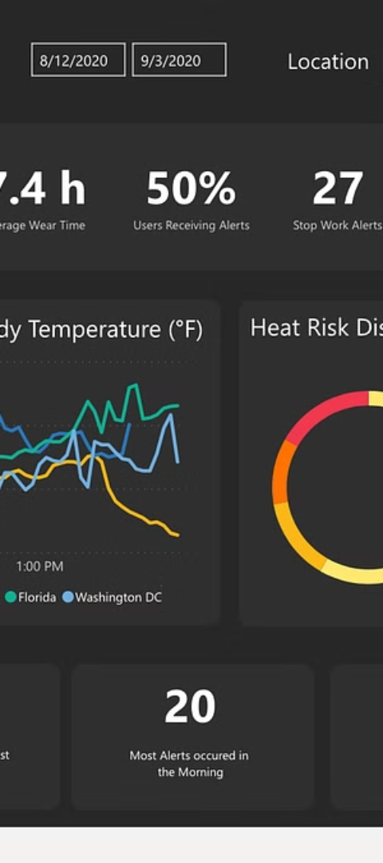
Significance
Automation improves PPE detection, enhancing workplace safety and fostering a safety-focused culture.
Minimizing human error in PPE inspection creates safer working environments and lowers accident risks.
Enhanced PPE compliance reduces workplace incidents, insurance claims, and regulatory fines.

Slide 6
Cost/Benefit Analysis:
Cost Analysis:
Initial development costs including hardware, software.
Ongoing maintenance and support expenses.
Integration costs with existing infrastructure and surveillance systems.
Benefit Analysis:
Reduction in accident rates and associated costs (medical expenses, worker compensation, legal fees).
Improved productivity due to streamlined PPE inspection processes.
Long-term cost savings through automation and efficiency gains.

Slide 7
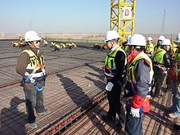
Business Case
Market Opportunity:
Growing emphasis on workplace safety regulations and compliance.
Increasing adoption of automation technologies in industrial sectors.
Potential for expansion into other industries beyond manufacturing, such as construction and healthcare.
Competitive Advantage:
Unique selling proposition (USP) of real-time PPE detection and compliance monitoring.
Differentiation through advanced deep learning algorithms and robust performance.
Revenue Model:
Licensing fees for software usage.
Subscription-based models for ongoing support and updates.
Customization and integration services for specific client needs.
This Photo by Unknown author is licensed under CC BY-SA.

Slide 8
KPIs(Key Performance Indicators):
Performance Metrics:
Accuracy and precision of PPE detection.
Detection speed and real-time processing capabilities.
False alarm rates and system reliability.
Business Metrics:
Return on Investment (ROI) based on cost savings and revenue generation.
Customer satisfaction and retention rates.
Market share and penetration in target industries.
Operational Metrics:
System uptime and availability.
Response time to alerts and incidents.
Scalability and adaptability to changing operational needs.

Slide 9
Literature Review
Past Available Projects:
COVID-19 PPE Dataset for Object Detection, Safety Helmet Detection, etc.
Revealed a gap in automated PPE detection solutions.
Existing methods lack robustness, scalability, and real-time performance.
Previous attempts relied on traditional computer vision techniques, struggling with complex environments and varying lighting conditions.
Drawbacks of Existing Solutions:
Low accuracy, limited adaptability, and high computational requirements.
Challenges like occlusion, small object detection, and class imbalance remain unresolved in many projects.
Our Project:
Developed a single object detection model for various PPE types: fall-detection, safety helmets, masks, gloves, vests, coats, glasses, etc., tailored for construction, medical, and diverse industries.

Slide 10
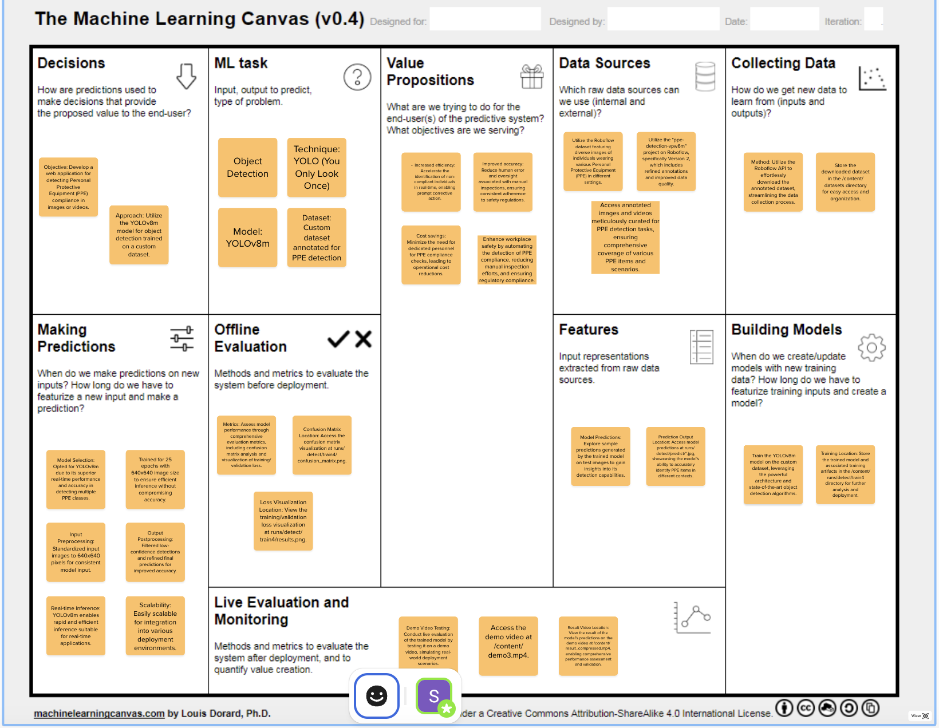
Methodology – ML Canvas:

Slide 11
Model Training & Benchmarking:
Data Collection:
First labeled dataset from Roboflow for Construction PPE with 2197 total images of PPE.
Class Labels: boots, gloves, helmet, vest
Second labeled dataset from Roboflow for Medical PPE with 1099 total images of PPE.
Class Labels: coat, glasses, glove, mask
Third label dataset from Roboflow for Custom PPE with 44002 total images of PPE.
Class Labels: fall-detected, gloves, goggles, hard-hat, ladder, mask etc.
Data Preparation:
Conducted preprocessing for image augmentation
Ensured dataset balance across PPE categories to avoid bias.
Model Training:
Used YOLOv8 architecture with transfer learning for PPE detection.
Fine-tuned the model for enhanced performance on the custom dataset.
Evaluation Metrics:
Achieved 75% accuracy in PPE item identification.
Evaluated using precision, recall, and mAP50-95 metrics.
Key Achievements:
Improved detection accuracy compared to traditional methods.
Demonstrated robust performance in real-world environments.
Validated effectiveness through benchmarking against existing solutions.

Slide 12
Model Training & Benchmarking:
Model | Dataset | Epochs | Precision | Recall | mAP50-95
Yolov8m | Construction PPE | 24 | 0.86859 | 0.8072 | 0.64982
Yolov8m | Medical PPE | 49 | 0.75158 | 0.67678 | 0.37554
Yolov8m | Custom PPE | 9 | 0.62304 | 0.64247 | 0.36837

Slide 13
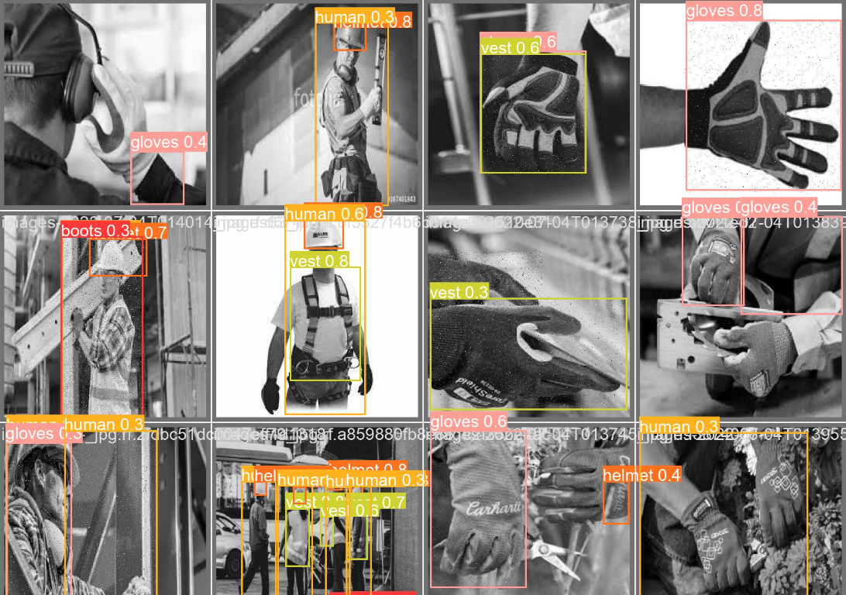
Deployment Environment:
Utilized Render for deploying the PPE detection model.
Deployment Files:
Notebook: Used for model training and experimentation.
Python Script (Yolo_Video_Detection.py): Contains code for real-time video detection.
Main Script (main.py): Handles web application functionalities.
Requirements.txt: Lists necessary dependencies for the project.
Model Deployment:

Slide 14
Demo:
Construction PPE Detection: Experience the power of our model as it accurately identifies crucial safety gear like helmets, vests, and goggles, vital for construction site personnel's protection.
Medical PPE Detection: Witness the precision of our model in recognizing essential medical gear such as masks, gloves, and gowns, pivotal for safeguarding healthcare professionals on the frontline.
Custom PPE Detection: Explore the versatility of our custom model, adept at detecting a diverse array of PPE across various industries. From standard safety equipment to specialized features like fall detection, our solution ensures comprehensive safety monitoring tailored to your needs.

Slide 15
Challenges & Issues Encountered:
Limited annotated dataset availability posed initial challenges in model training and validation.
Overcoming computational resource constraints for training large-scale models, particularly in resource-constrained environments.
Addressing class imbalance and data distribution issues during model training to prevent bias and improve generalization.

Slide 16
Future Scope:
Model Enhancement: Improve model accuracy and robustness through fine-tuning and advanced techniques like attention mechanisms.
Real-Time Monitoring: Implement automated surveillance for continuous PPE compliance monitoring in industrial settings.
Cross-Sector Implementation: Extend PPE detection to diverse sectors including healthcare, construction, manufacturing, and more.
Public Spaces: Implement PPE detection in public spaces like airports, train stations, and malls to enforce safety regulations during pandemics and emergencies.

Slide 17
THANK YOU

